Slide 1
SMART TELEPHONING
Workshop for SMK Link & Match
24 November 2025

Slide 2
TELEPHONING ETIQUETTE
Answer the phone promptly (maximum 3 rings)
Greet the caller and identify yourself
Use a friendly, clear, and professional tone of voice
Listen actively
Note down important information
Do not put the caller on hold for too long
Convey information accurately and precisely
Use polite and neutral language
Hang up the phone politely

Slide 3
WHY IT’S IMPORTANT?
  Creating a professional impression
  Improving communication quality
  Building good relationships with clients or partners
  Representing the company's image and reputation
  Avoiding misunderstandings or communication conflicts

Slide 4
NOTE-TAKING ESSENTIALS
Caller ID (name, company/agency)
Caller contact information (telephone number, email address)
Purpose/purpose of the call
Time of call (day, date, time)
Message to be conveyed
Confirmation of important information is carried out so that the message conveyed to superiors is accurate and facilitates follow-up.
*)

Slide 5
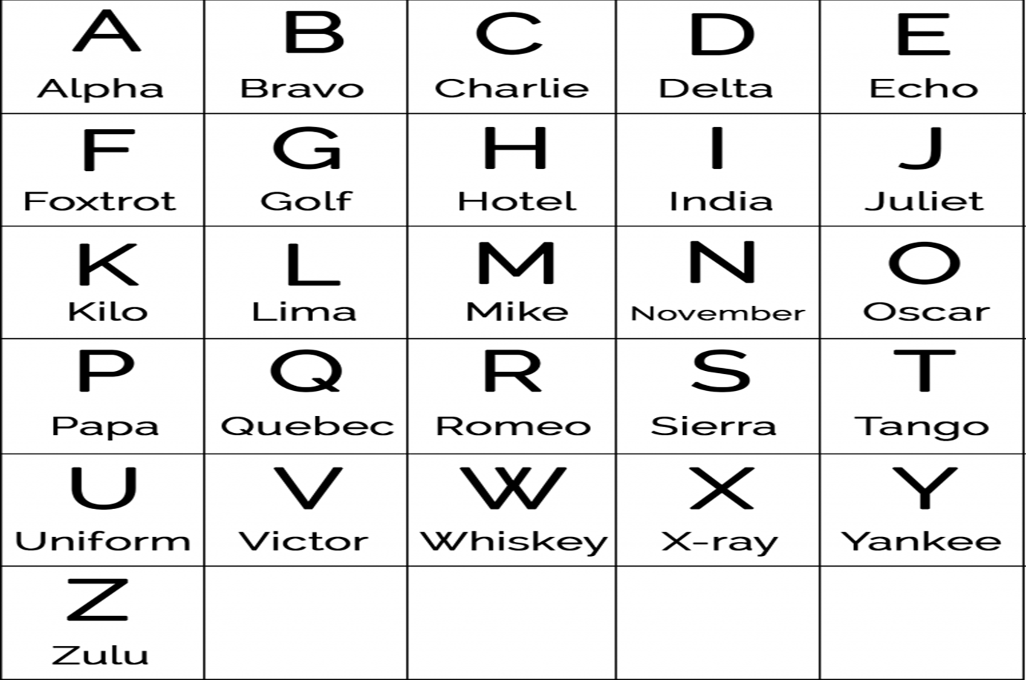

Slide 6
CONTOH PERCAKAPAN 1
Ayu: Selamat pagi, PT Prima Jaya, dengan Ayu, ada yang bisa saya bantu?
Rudi: Selamat pagi, Bu Ayu. Ini dengan Bapak Rudi dari CV Mandiri. Saya ingin membuat janji temu dengan Bapak Direktur.
Ayu: Maaf, Bapak ingin bertemu mengenai hal apa dan kapan kira-kira waktu yang Bapak inginkan?
Rudi: Saya ingin menyampaikan laporan perkembangan kerja sama. Untuk waktunya, kalau bisa awal minggu depan.
Ayu: Baik, saya cek jadwal beliau terlebih dahulu… (3 detik) Untuk Senin pukul 10.00 atau Selasa pukul 14.00 masih tersedia. Mana yang lebih sesuai untuk Bapak?
Rudi: Senin pukul 10.00 saja, Bu.
Ayu: Baik, Pak. Saya jadwalkan pertemuan pada Senin, pukul 10.00. Apakah ada nomor telepon dan alamat email yang bisa saya catat?
Rudi: Ada, Bu. Nomor telepon saya: 021-844 4931. Alamat e-mail saya: rudi@cvmadiri.co.id.
Ayu: Saya ulang informasinya ya, Pak. Bapak Rudi dari CV Mandiri, janji temu pada hari Senin, 1 Desember jam 10 telepon 021-844 4931. Alamat e-mail: rudi@cvmadiri.co.id. Benar begitu ya, Pak?
Rudi: Benar.
Ayu: Baik, terima kasih, Pak Rudi. Apakah ada yang bisa saya bantu lagi?
Rudi: Cukup, Bu. Terima kasih banyak.
Ayu: Sama-sama, Pak. Selamat pagi.

Slide 7
EXAMPLE 2
Maya: Good morning, Sunrise Corporation. This is Maya speaking. How may I help you?
Wilson: Good morning, Ms Maya. This is Mr Wilson from Global Partners. I’d like to check if Mr Andrew is in the office today.
Maya: Please hold for a moment while I check his schedule… (3 seconds) Thank you for waiting. Mr Andrew is currently out of the office today due to an external meeting.
Wilson: I see. In that case, I’d like to schedule an appointment with him.
Maya: Certainly, sir. May I know the purpose of the meeting and your preferred time?
Wilson: It’s regarding our quarterly project update. I prefer sometime early next week.
Maya: Let me check his availability… (3 seconds) He is available on Monday at 10 a.m. or Tuesday at 2 p.m. Which one works better for you?
Wilson: Monday at 10 a.m. would be perfect.
Maya: Great. I’ll book the appointment for Monday at 10 a.m. I will also send a confirmation email. May I have your email address?
Wilson: Yes, it’s wilson@globalpartners.com.
Maya: wilson@globalpartners.com. Is there anything else I can assist you with?
Wilson: No, that’s all. Thank you.
Maya: You’re welcome. Have a great day.

Slide 8

EXAMPLE 3
A: Good morning. ISI Bank
B: Could I speak to Mr Fisher, please?
A: He’s in a meeting at the moment. Can I help?
B: It's Imran Shah here. Could I make an appointment to see him sometime this week?
A: Just a moment. I’ll check his diary. What about Friday 14th at 2.30.
B: Yes, that’s fine. Friday 2.30.
A: May I ask what it’s about?
B: I’d like to talk to him about some new investments.
A: OK, fine. We’ll see you then.
B: Thanks very much
A: You’re welcome. Goodbye.
B: Bye.

Slide 9
EXAMPLE 4
A: Good afternoon. Ray Cohen’s office.
B: Hello. This is Kumiko Chen from Accounts. I need to make an appointment with Mr Cohen as soon as possible.
A: Just one second, Ms Chen. When would suit you?
B: In the morning, if possible. This Wednesday or Thursday?
A: What about Thursday at 9.30?
B: That’s perfect.
A: Can you tell me what it’s about?
B: Yes, it’s about the latest sales figures.
A: Alright, I’ll put it in his diary. So, that’s Thursday, the 29th, at 9:30.
B: Thank you very much.
A: Don't mention it. Goodbye.
B: Goodbye.

Slide 10
SITUASI 1
A
B
Anda adalah seorang sekretaris Presiden Direktur PT WINGS. Atasan Anda sedang tugas keluar kota sampai hari Rabu 26 November 2025. Anda menerima telepon dari seorang mitra kerja Presiden Direktur yang ingin membuat janji temu. Tulis pesan yang disampaikan penelpon secara tepat untuk Anda sampaikan ke atasan Anda.
Anda adalah seorang manajer riset dan pengembangan PT Calbee. Anda ingin bertemu dengan Presiden Direktur PT WINGS untuk membicarakan kemungkinan kolaborasi dengan PT WINGS terkait pengembangan dan pemasaran produk makanan ringan.

Slide 11
SITUATION 2
A
B
You are Mr Andre’s secretary. Call Mr Devan’s secretary and inform her that your boss has an appointment with him at 1 pm, but he is delayed at Soekarno Hatta airport. He might not be able to make the meeting. Ask for a new appointment tomorrow at 10 am or 3 pm.
You are Mr Devan’s secretary. Take the call and respond accordingly. Arrange an appointment for Mr Andre according to your boss's schedule in the appointment book.

Slide 12
Speaking Practice
BERTELEPON

Slide 13
THANK YOU

